Slide 1
PROFESSIONAL EXPERIENCE - Worked as a Systems Engineer at Tata Consultancy Services Ltd. for 2.5 years - Grew from a Front End JAVA Web Application Developer to become the Project Module lead - Project Name: TCS- CCW- Build & Price (TCS-CISCO) - Project Type: Web Application Development Team
SAURABH JAPE

Slide 2
Web Application Experience:
Design of CSS and HTML
Developing JSP pages
Worked on Javascript, JQuery, Angular JS and Underscore JS, SQL
Managed data flow and navigation using Struts+Java Spring MVC.
Managed data storage and update using DAO layer and hibernate calls.
Deployment of code on application servers.
Application Flow:
Web Application -> JavaScript/Jquery -> Data handling -> DAO layer / hibernate
User Interface AJAX Calls and business logic Data saved/updated
( JSP, HTML, CSS) at JAVA in Database

Slide 3
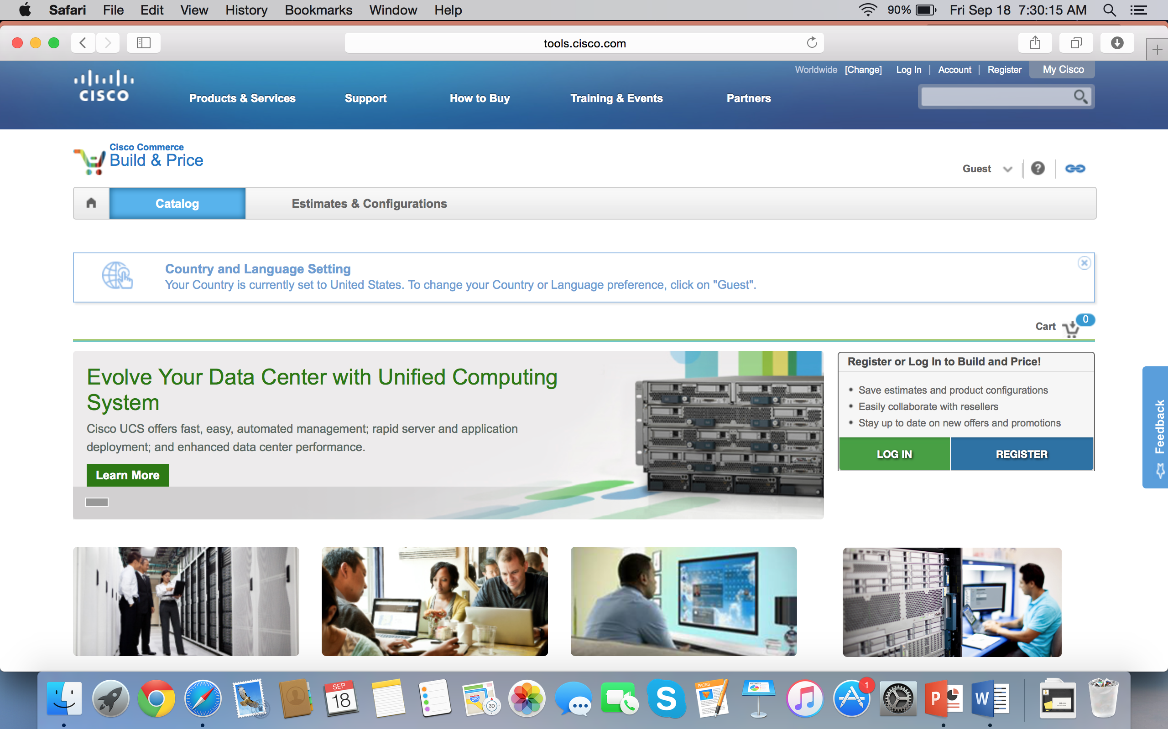
Web Application Screenshot that I worked on

Slide 4
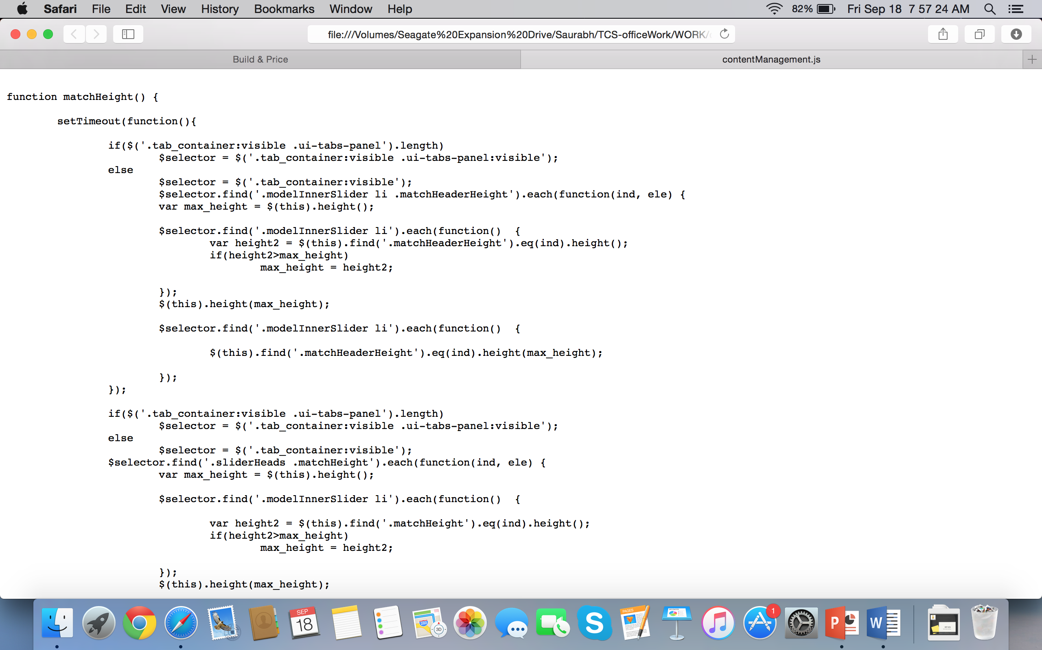
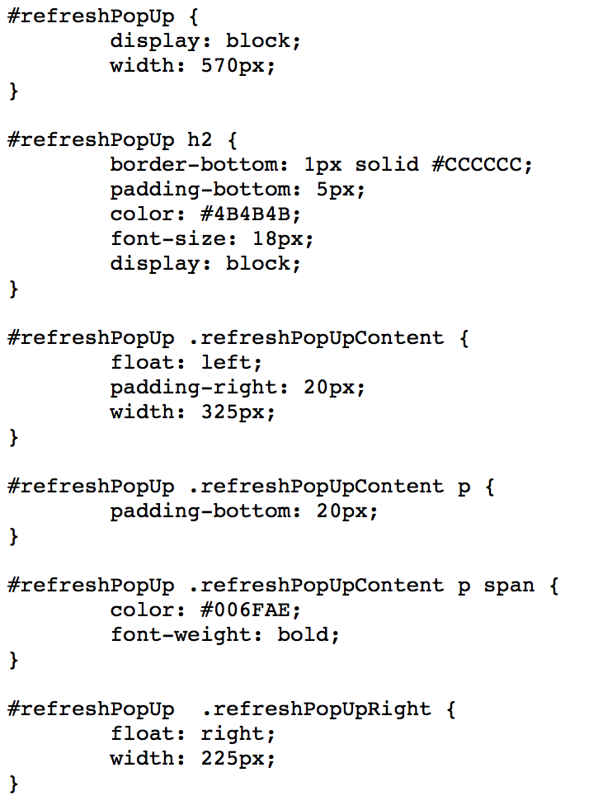
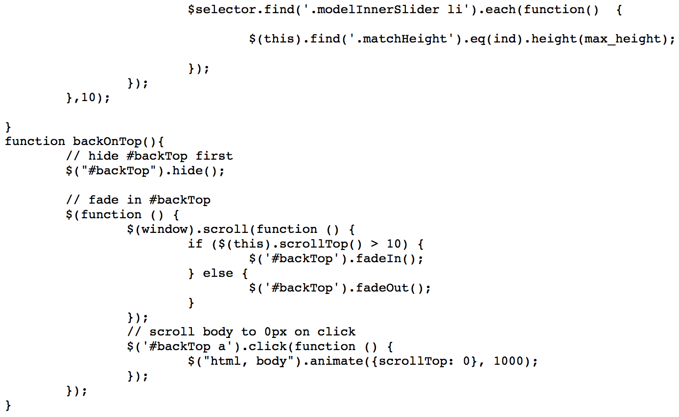
Javascript File
CSS File
SAMPLE CODES:

Slide 5
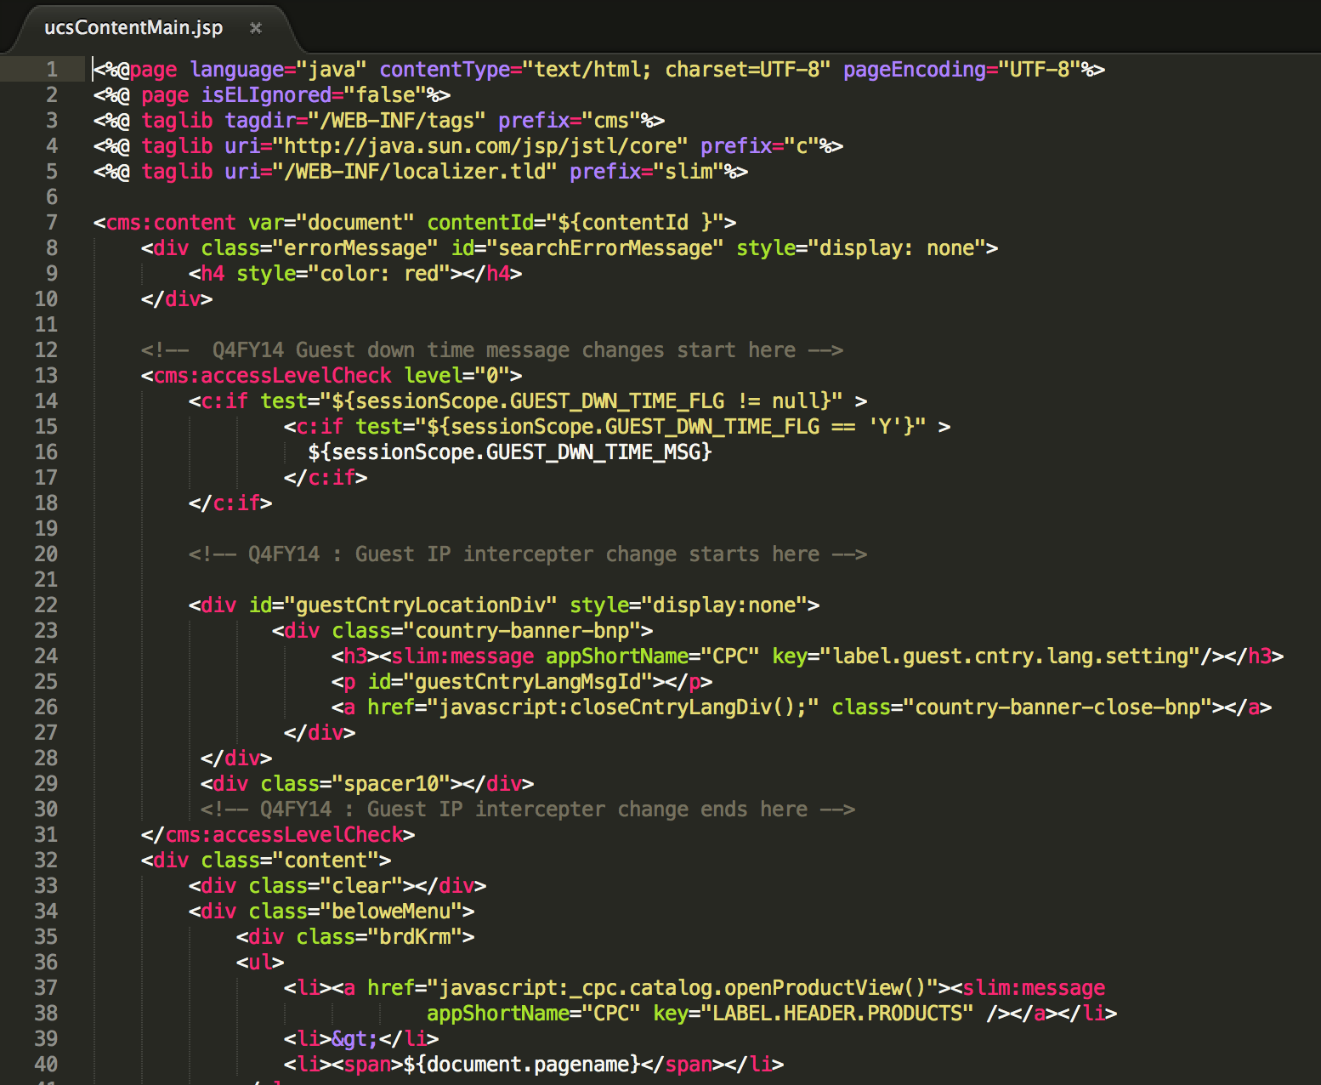
JSP File
SAMPLE CODES:

Slide 6
JSP File
SAMPLE CODES:

Slide 7
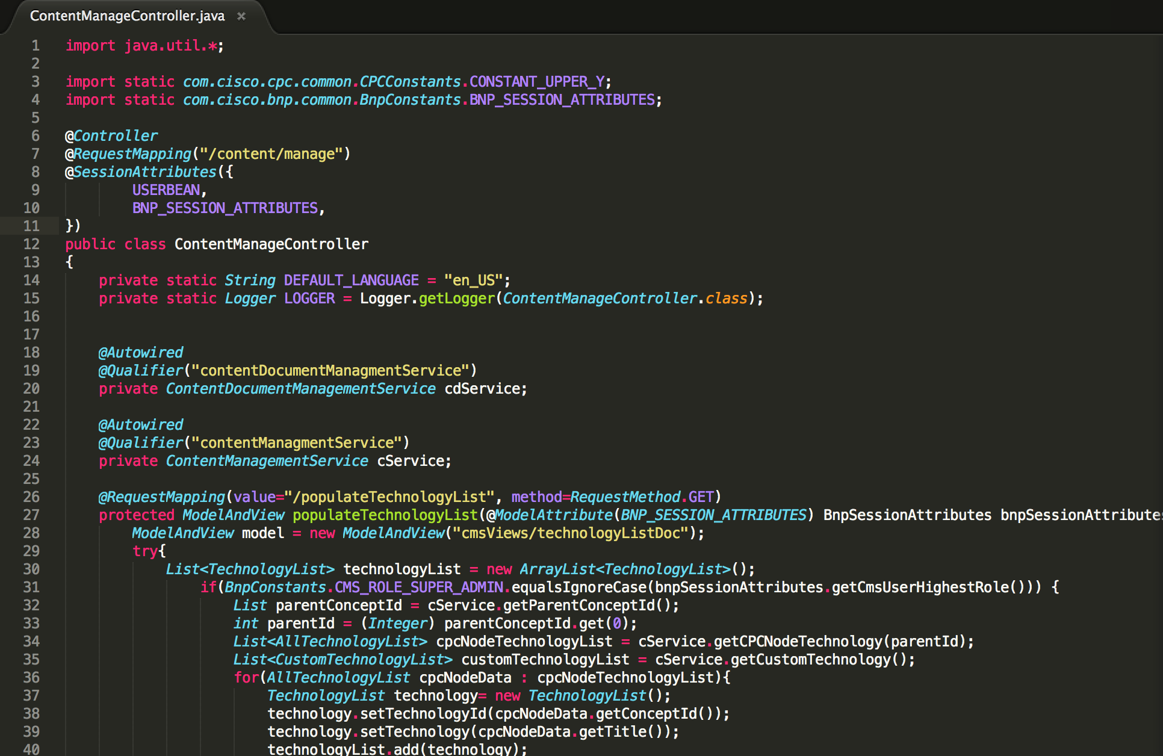
JAVA File
SAMPLE CODES:

Slide 8
THANK YOU

